Slide 1
Find Hope for Recovery from Psychiatric Illness
Break the Stigma of Mental Illness

Slide 2
It is only natural for us to fear what we do not understand.

Slide 3
Fear and uncertainty about mental illness can lead to assuming things that are not true, or stigma.

Slide 4
Although progress is being made to remove the negative stigma many people have about mental illness…….

Slide 5
We still have a long way to go to overcome the mistaken beliefs, fears, and prejudices created by these attitudes.

Slide 6
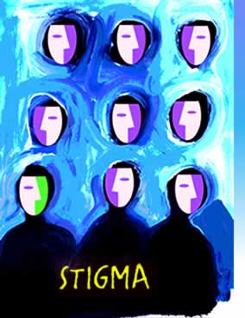
Definition of Stigma….
A stigma is a behavior, trait, or reputation that is socially unacceptable.
That “mark” could cause others to viewed people as undesirable or reject them based on assumptions instead of accepting them for who they are.

Slide 7
Because stigmas are based on myths and misunderstandings…… they can be negative, hurtful, and dangerous.

Slide 8
Stigma is more than the use of harmful words or actions…..
Stigmas can be a barrier between people….
Stigmas can keep people and their families from getting the help they need if they are afraid of discrimination….

Slide 9
Stigma of mental illness can make it harder to get insurance coverage for mental health services.

Slide 10
Stigma can cause fear, mistrust, and sometimes violence against people living with mental illness.

Slide 11
Stigma can sometimes result in families and friends turning their backs on people with mental illness.

Slide 12
Stigma keeps people from seeking the mental health services they need and deserve.

Slide 13
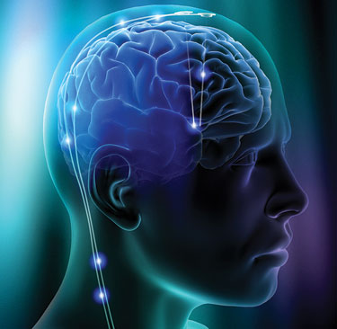
What are Mental Illnesses?
Mental illnesses are medical conditions that may affect the brain chemicals produced.
Mental illnesses disrupt a person's thinking, feeling, mood, ability to relate to others, and ability to function.

Slide 14
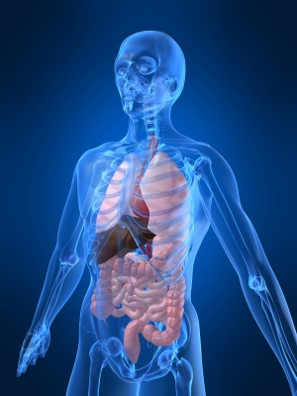
So, the real question is…..
Why is a Stigma attached to a disorder of the brain when there is no stigma attached to diseases of other organs of the human body?

Slide 15
Is There Stigma with these Disorders?
Lung diseases
Diabetes
Heart diseases
Vision problems
Bone and Skin Diseases
Arthritis
Kidney Disease
Liver Disease
Any type of CANCER….

Slide 16
Is There Stigma with These Disorders?
Alcohol and Drug Addictions
Attention Deficit Hyperactivity Disorder
Autism
Dementia or Alzheimer’s Disease
Learning Disorders
Post Traumatic Stress Disorder
Sleep Disorders
Eating Disorders (like Bulimia and Anorexia Nervosa)

Slide 17
Is There Stigma with These Disorders?
Anxiety Disorder
Panic Disorder
Bipolar Disorder
Borderline Personality Disorder
Depression
Schizophrenia
Obsessive – Compulsive Disorder

Slide 18
Mental illnesses are medical conditions that often result in a diminished capacity for coping with the ordinary demands of life.
…..Just as with any other medical diagnosis.

Slide 19
Even though these are ALL mental illnesses and disorders, ask yourself……

Slide 20
Have you ever stigmatized others?

Slide 21
Discussion:

Slide 22
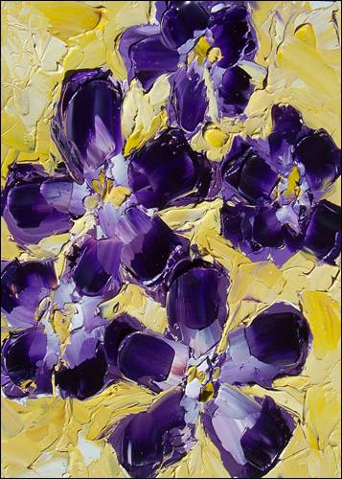
We are ALL guilty…..
but we can change.

Slide 23
Stigma: Revealing the Facts and Busting the Myths

Slide 24
MYTH
People with mental illness are usually poor, less intelligent and less educated.

Slide 25
FACT
Like a physical illness, mental illness can affect people of all ages and all “social classes”.
People in any type of job, of all levels of education and income levels can have mental illness.

Slide 26
There are MANY famous people: scholars, actors, artists,
musicians, and others that have mental illness.

Slide 27
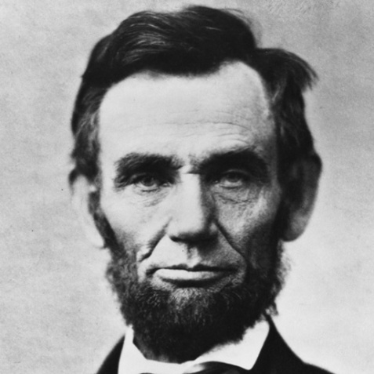
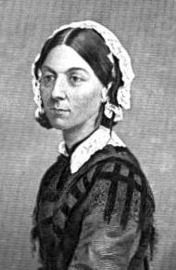
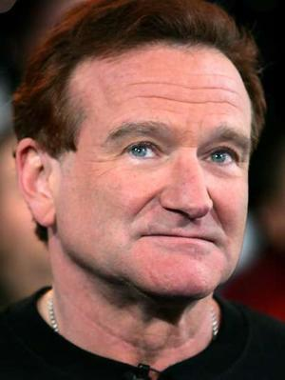
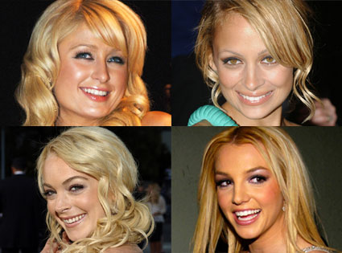
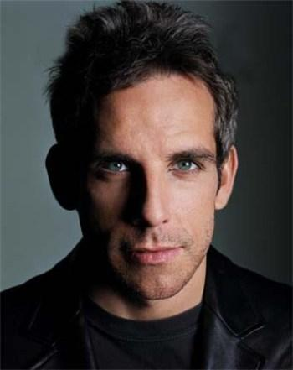
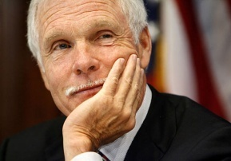
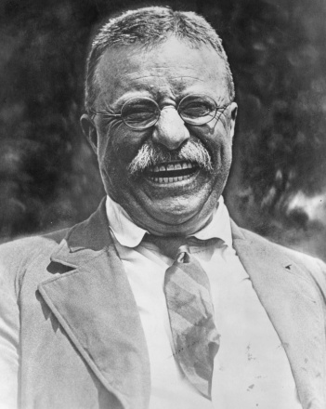
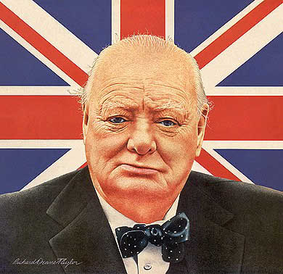
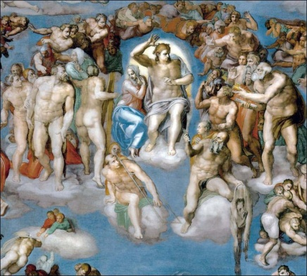
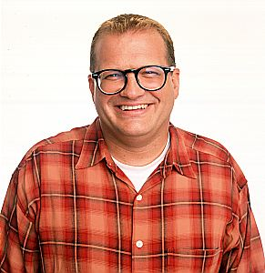
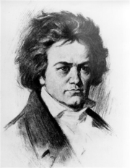
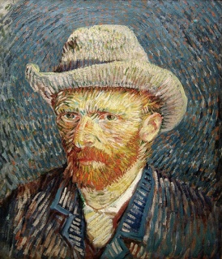
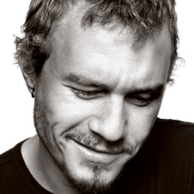
Faces of Mental Illness

Slide 28
…..these people with psychiatric illnesses have all led creative, productive lives.

Slide 29
Discussion:

Slide 30
MYTH
All mentally ill are violent and unpredictable.

Slide 31
FACT
Mentally ill persons are no more violent than any other “group” of people.
In fact, they are more likely to be victims of violence.

Slide 32
Our knowledge of mental illness has been limited
There are a lot of myths, misunderstandings negative attitudes about mental illness.
A main source of information about mental illness comes from movies and television. This is often a distorted and inaccurate way to describe mental illness.
News stories have only focused on the high profile, dramatic …..random cases linked to people with mental illness.

Slide 33
MYTH
Mental Illness happens because of a personal weakness or “character flaw”.

Slide 34
FACT
Mental illnesses have very complex causes. A mix of genetics (family history), biology and life experiences can contribute. Most of these are beyond a person’s control.

Slide 35
It’s an illness! It has nothing to do with being weak or lacking will power. People with mental illness do not choose to become ill. They are not lazy and they can not “just snap out of it”.

Slide 36
Could you imagine thinking or telling someone with cancer or a heart condition that they should “just snap out of it” ?
Do you think they can they just get rid of their condition instantly by wanting to?

Slide 37
Of course not! - People with illnesses can’t snap their fingers and make it all go away, and they can’t simply “pull themselves up by their bootstraps” and suddenly be well.
It is the same with psychiatric illnesses – It usually takes some time to recover.

Slide 38
MYTH
Young people and children don’t suffer from mental health problems.

Slide 39
FACT
More than 6 million young people in America may suffer from a mental health disorder. Those illnesses can severely disrupt their ability to function at home, in school, or in their community.

Slide 40
MYTH
If a person has a mental illness, it is a sign of weakness – it’s their fault.

Slide 41
FACT
Psychiatric illness is no one’s fault, anymore than heart disease or diabetes is a person’s fault.
Mental illnesses are NOT conditions that people choose to have or not have.
Mental illnesses are not a choice. No one should have to feel ashamed of this condition any more than any other medical condition.

Slide 42
MYTH
If a person seeks help for their mental health problem, others will think they are “crazy.”

Slide 43
FACT
No one should delay getting treatment for a mental health problem.
Some people worry that others will avoid them if they seek treatment for their mental illness.
Early treatment can produce better results.
Seeking help is a sign of strength, not weakness.

Slide 44
MYTH
Most people with mental illness are homeless or in mental hospitals.

Slide 45
FACT
Over two-thirds of Americans who have a mental illness live in the community and lead productive lives.
Most people who need hospitalization for a mental illness are only there for brief times to get treatment and are then able to return home…….

Slide 46
Education is essential
Now is the time to get educated about mental illness.
With discussion and education, fears and misconceptions disappear.
Education….Creates Understanding.

Slide 47
Recovery and Mental Health
There is a need for a change in thinking – an understanding that recovery from mental illness is not only possible, it happens all the time.
Stigmatizing mental illness undermines recovery from it.
A shift in emphasis from mental illness to mental health is needed.

Slide 48
Many organizations are committed to helping people with mental illness, being an advocate for mental health issues, promoting awareness, and providing safe, supportive and compassionate places for treatment.

Slide 49
It is time to remove the stigma of mental illness… take the barriers down!

Slide 50
References
Schwartz Allan, PH.D. (2011). Mental Help.net. The Stigma of Mental Illness Persists. Retrieved on February 21, 2011, from http://www.mentalhelp.net/poc/view_doc.php?type=doc&id=35536
Washington State Department of Social and Health Services. (2007). Mental Health Transformation Grant Archive from http://mhtransformation.wa.gov/MHTG/stopstigma.shtml or http://www.dshs.wa.gov/dbhr/mhtransgrant.shtml
By Shari Cavadini, RN (2011). Edited by Mary Knutson RN. Revised 4-24-15

