Slide 1
Mental Health Nursing: Anxiety Disorders
By Mary B. Knutson, RN, MS, FCP

Slide 2
A Definition of Anxiety
Diffuse apprehension that is vague in nature and associated with feelings of uncertainty and helplessness

Slide 3
Levels of Anxiety
Mild: Tension of day-to-day living
Moderate: Focus on immediate concerns
Severe: All behavior is aimed at relieving anxiety
Panic: Dread, terror, abrupt distress
Details are blown out of proportion
Disorganization of personality
Increased motor activity, physical sx
Loss of rational thought

Slide 4
Autonomic Nervous System
Sympathetic body processes:
“Fight or flight” reaction (epinephrine)
⇧ respirations, BP, and heart rate
Blood shifts away from GI tract to heart, central nervous system, and muscle
Blood glucose level rises
Tension, restlessness, tremors, pacing, fear, sweating, face flushed or pale
Parasympathetic body processes can coexist:
“Breed or feed” reaction

Slide 5
Mild or Moderate Anxiety
Frequently expressed as anger
Self-esteem is related to anxiety
May be caused by frustration
Often not a medically diagnosed health problem

Slide 6
Moderate or Severe Anxiety
Neurosis: Maladaptive anxiety disorder without distortion of reality
Psychosis: Panic level “breaking into pieces”, and fear of inability to cope

Slide 7
Anxiety and depression symptoms can overlap:
Sleep disturbance, appetite changes, cardiac and GI problems, poor concentration, irritability, or change in energy level

Slide 8
Somatoform Disorders
Psychophysiological disruptions with no organic impairment, related to anxiety
May have illness, disability, pain, or sleep disturbance
Unconscious coping with anxiety or overwhelming stress
Provide a way to receive help, without admitting the need
May protect from expressing frightening aggressive or sexual impulses

Slide 9
Somatoform Illnesses
Somatization disorder- many physical complaints
Conversion disorder- loss or alteration of physical functioning
Hypochondriasis- fear of illness or belief that one has an illness
Body dysmorphic disorder- normal appearance, but concerned about physical defect
Pain disorder- involving psychological role
Sleep disorders- usually insomnia

Slide 10
Predisposing Factors
Psychoanalytical
Interpersonal
Behavioral
Family
Biological perspectives
Precipitating stressors include threats to physical integrity and self-system

Slide 11
Alleviating Factors
Coping resources include intrapersonal, interpersonal, and social factors:
Economic assets
Problem-solving abilities
Social supports
Cultural beliefs

Slide 12
Medical Diagnosis
Panic Disorder with or without agoraphobia (fear of being in places unable to escape, or in embarrassing situations)
Phobia: Excessive and persistent fear
Obsessive-compulsive disorder
Posttraumatic stress disorder
Acute stress disorder
Generalized anxiety disorder

Slide 13
Examples: Nursing Diagnosis
Fear related to financial pressures evidenced by recurring episodes of abdominal pain.
Severe anxiety related to family rejection evidenced by confusion and impaired judgment.
Ineffective individual coping related to illness evidenced by limited ability to concentrate, and psychomotor agitation.

Slide 14
Nursing Care
Assess subjective and objective responses
Recognize defense mechanisms
Task-oriented reactions: Attack, withdrawal, compromise
Ego-oriented reactions: Compensation, denial, displacement, dissociation, identification, intellectualization, introjection, isolation, projection, rationalization, reaction formation, regression, repression, splitting, sublimation, suppression, or undoing

Slide 15
Implementation
Establish trusting relationship
Monitor self-awareness
Protect the patient
Modify the environment
Encourage activity
Administer medication
Recognize anxiety
Utilize pt insight to cope with threats
Promote relaxation response

Slide 16
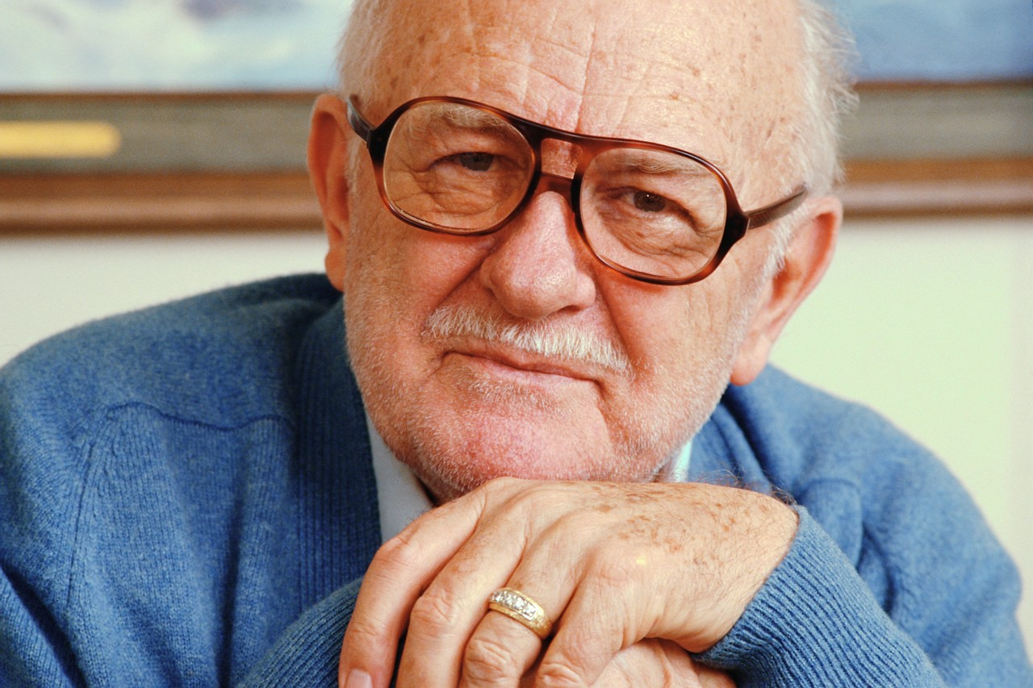
Anti-anxiety Drugs
Benzodiazepines
Alprozolam (Xanax)
Clonazepam (Klonopin)
Diazepam (Valium)
Lorazepam (Ativan)
Chlordiazepoxide (Librium)
Chlorazepate (Tranxene)
Oxazepam (Serax)
Halazepam (Paxipam)
Prazepam (Centrax)

Slide 17
Anti-anxiety Drugs (continued)
Antihistamines
Diphenhdramine (Benadryl)
Hydroxyzine (Atarax)
Noradrenergic agents
Clonidine (Catapres)
Propranolol (Inderol)
Anxiolytic
Buspirone (Buspar)
Antidepressant drugs may also be helpful to reduce anxiety

Slide 18
Evaluation
Patient Outcome/Goal
Patient will demonstrate adaptive ways of coping with stress
Nursing Evaluation
Was nursing care adequate, effective, appropriate, efficient, and flexible?

Slide 19
References
Stuart, G. & Laraia, M. (2005). Principles & practice of psychiatric nursing (8th Ed.). St. Louis: Elsevier Mosby
Stuart, G. & Sundeen, S. (1995). Principles & practice of psychiatric nursing (5th Ed.). St. Louis: Mosby

