Slide 1
Mental Health Nursing: Eating Disorders
By Mary B. Knutson, RN, MS, FCP

Slide 2
Maladaptive Eating
Food may be used to satisfy unmet emotional needs, to moderate stress, and to provide rewards or punishments
People can have unrealistic images of their ideal body size and desired body weight

Slide 3
Continuum of Eating Regulation Responses
Adaptive responses:
Balanced eating patterns, appropriate caloric intake, and healthy body weight
⬄ Occasional overeating or skipping meals
⇦ Overeating or fasting under stress ⇨
Maladaptive responses:
⬄ Frequent bingeing, fasting, night eating, or severe dieting
⇦ Anorexia, Bulimia, Binge eating disorder, or Night eating syndrome

Slide 4
Maladaptive Eating Illnesses
Inability to regulate eating habits and the frequent tendency to overuse or underuse food
Interferes with biological, psychological, and sociocultural integrity
Sociocultural norms may result in a distorted body image

Slide 5
Scope of the Problem
Eating disorders can cause biological changes that include altered metabolic rates, profound malnutrition, and possibly death
Obsessions about eating can cause psychological problems like depression, isolation, and emotional lability

Slide 6
Eating Disorders
Anorexia nervosa occurs in approximately 0.5% to 1% of females
About 5% to 10% with anorexia are male
Usual onset between 13 and 20, but can occur in any age
Although hungry, a person with anorexia refuses to eat because of distorted self-perception of fatness
Starvation ensues
Can become a chronic illness
Estimated mortality from anorexia nervosa is 5% of those with the disorder

Slide 7
Eating Disorders (continued)
Bulimia nervosa is more common,
Estimated to occur in 1% to 4% of population, mostly in females
4% to 15% of female high school and college students
Onset usually at 15 to 18 years old
Uncontrolled binge eating alternating with vomiting or dieting
Bulimia and anorexia both may be present in the same patient
Bulimia usually occurs in people of normal weight, but may be in obese or thin people

Slide 8
What is Purging?
Behaviors may include:
Excessive exercise
Forced vomiting
Over-the-counter or prescription diuretics, diet pills, laxatives, or steroids
Laxative abuse is common, but it is an inefficient way to lose calories

Slide 9
More Eating Disorders
Binge Eating Disorder is consuming large amounts of calories in a contained amount of time
Differs from bulimia because they do not attempt to prevent wt gain by purging behaviors
Prevalence is approximately 2% to 4% of population

Slide 10
Night eating syndrome includes pattern of awakening during the night that is associated with food intake
It is not yet listed as a separate eating disorder in DSM-IV-TR
Prevalence is estimated to be 1.5% in general population and 27% among severely obese population seeking surgical tx

Slide 11
Medical Complications of Eating Disorders
CNS- Fatigue, seizures, weakness
Renal- Hematuria, proteinuria, and renal calculi
Hematological- Anemia, leukopenia
GI- Dental caries and erosion, esophagitis, gastric dilatation, pancreatitis, high cholesterol
Metabolic- Acidosis, dehydration, starvation, potassium depletion or hypokalemia, osteoporosis, alkalosis
Endocrine- Amenorrhea, irregular menses
CV- Bradycardia, postural hypotension, dysrhythmia (sudden death)

Slide 12
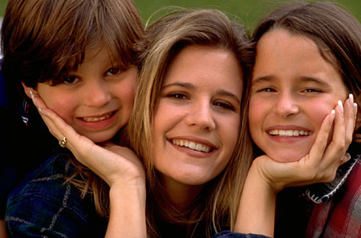
Predisposing Factors
Psychological- rigidity, perfectionism
Environmental- illnesses, sexual abuse, drug abuse, media influences
Familial- risk increases in female relatives
Biological- probable relationship to serotonin and dopamine levels (regulated in hypothalamus)
Precipitating stressors include peer pressure, daily solitude, interpersonal rejection or loss of a significant other

Slide 13
Psychiatric Complications
Many people with eating disorders also have depression, anxiety, and substance abuse
Bulimia may also be associated with posttraumatic stress disorder
People with antisocial personality disorders are more likely to have bulimia

Slide 14
Alleviating Factors
Important coping resource is motivation to change behavior
Includes intrapersonal, interpersonal, cultural, and social factors

Slide 15
Medical Diagnosis
Anorexia nervosa
Includes intense fear of gaining wt, and disturbed body image
>15% below minimum normal wt for age/ht
Can be restrictive type or binge-eating/purge type
Binge eating disorder
Bulimia nervosa
Diagnoses as listed in Diagnostic and statistical manual of mental disorders, ed 4, text revision, Washington DC, 2000, American Psychiatric Association.

Slide 16
Examples: Nursing Diagnosis
Anxiety related to fear of weight gain, e/b rituals associated with food preparation and eating
Disturbed body image related to fear of weight gain, e/b verbalization of being “fat” while being 30% below ideal weight
Powerlessness r/t perceived lack of control over eating behaviors, e/b inability to stop binge eating and avoidance of food-related settings
Imbalanced nutrition: more than body requirements e/b 40% over IBW, and sleep apnea

Slide 17
Nursing Diagnoses (continued)
Imbalanced nutrition: less than body requirements e/b being 25% below body IBW, and weakness r/t malnutrition and anemia
Chronic low self esteem r/t to feelings of low self-worth e/b verbalization of sole standard of success being r/t physical attractiveness
Risk for self-mutilation r/t feelings of inadequacy e/b injuries caused by excessive exercise and self-induced vomiting

Slide 18
Nursing Care
Assess subjective and objective responses
Recognize defense mechanisms
Denial, avoidance, intellectualization, isolation of affect
Choose outpatient or inpatient tx setting
Utilize nurse-patient contracts

Slide 19
Implementation
Stabilize nutritional status
Refeeding interventions such as NG tube feeding or total parenteral nutrition (TPN) are rarely used
Monitor activity
Promote family involvement
Utilize group therapies
Administer medication, if ordered
No drugs have been completely effective for anorexia, but antidepressants may be helpful

Slide 20
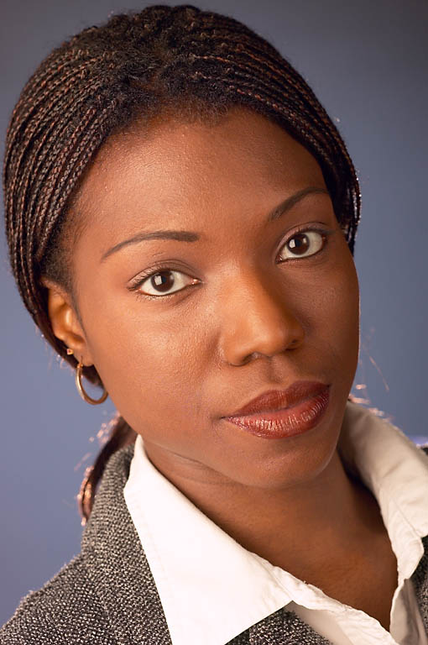
Interventions (continued)
Utilize cognitive behavioral intervention to help pts become aware of their cognitive distortions
Teach alternative eating regulation responses to assist in problem solving and making healthier decisions
Include body image intervention
Explain consequences of maladaptive eating responses
Set realistic goals together

Slide 21
Evaluation
Patient Outcome/Goal
Patient will restore healthy eating patterns and normalize physiological parameters related to body weight and nutrition
Nursing Evaluation
Was nursing care adequate, effective, appropriate, efficient, and flexible?

Slide 22
References
Stuart, G. & Laraia, M. (2005). Principles & practice of psychiatric nursing (8th Ed.). St. Louis: Elsevier Mosby

