Slide 1
Mental Health Nursing: Suicidal Behavior
By Mary B. Knutson, RN, MS, FCP

Slide 2
Self-Protective Responses
Protection and survival are fundamental needs of all living things
Life is characterized by risk
Individuals choose the amount of potential danger to expose themselves to
Low self-esteem leads to depression, which is always present in self-destructive behavior

Slide 3
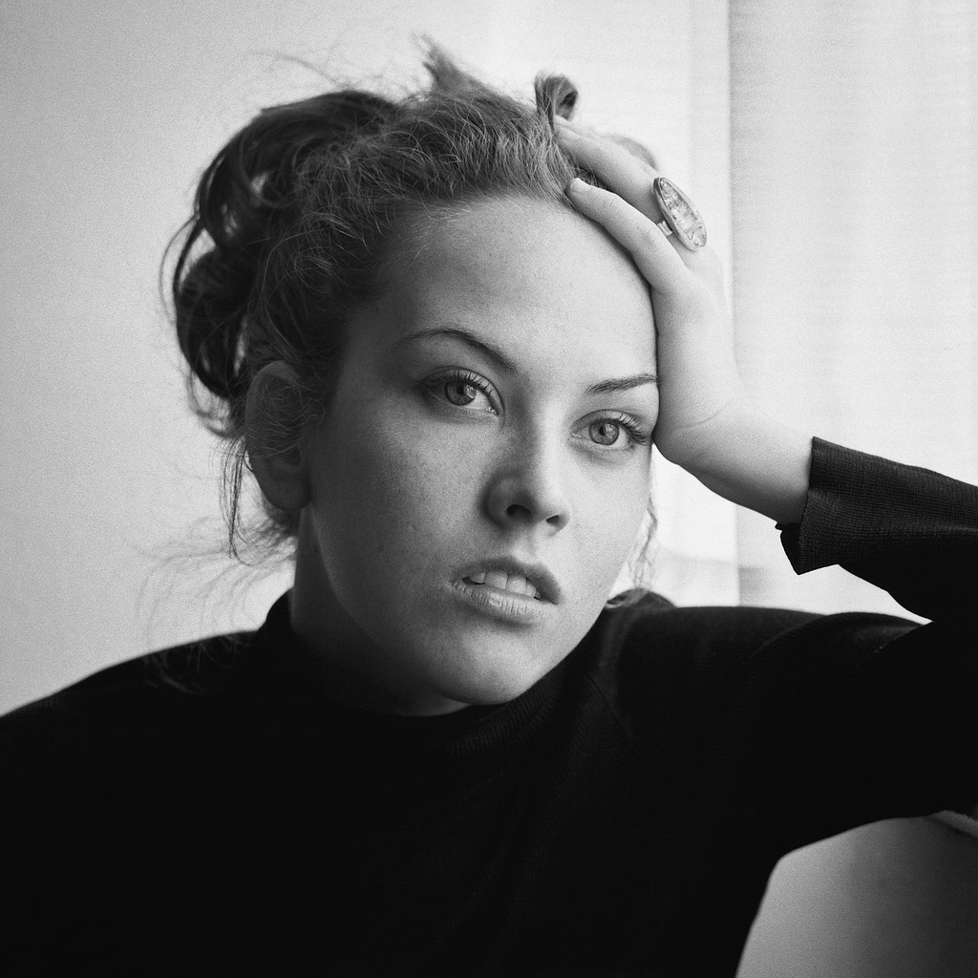
Self-Destructive Behavior
Any form of suicidal activity, such as suicide threats, attempts, gestures, and completed suicide

Slide 4
Self-Protective Response Continuum
Adaptive responses
Self-enhancement ⇦ Growth-promoting risk taking ⇨
⇦ Indirect self-destructive behavior ⇨
Maladaptive responses
Self-injury ⇨
Suicide

Slide 5
Comorbidity of Suicidal Behavior
Affective disorders
Substance abuse
Schizophrenia
Panic disorder
Adolescents who kill themselves tend to have depression and conduct disorders

Slide 6
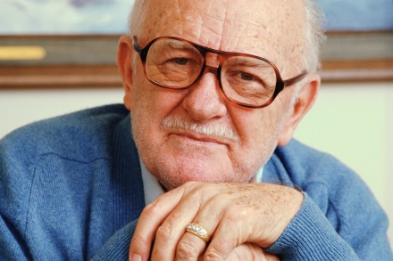
Suicide Statistics
About 30,000 people complete the act of suicide each year, making it the eighth leading cause of death in the U.S.
71% occur among white males
19% occur among white females
Rates increase between ages 15-24, and among people over 65 years old (especially age 75-85)

Slide 7
Suicide Attempts
Males use guns most of the time
Women usually use medication overdose or wrist slashing
Use of guns is increasing

Slide 8
Assessment of Behaviors
Noncompliance
Denial of seriousness of illness
Increased anxiety because illness may signify “getting old”
Struggle for control
Self-injury- Causing deliberate harm to one’s own body (cutting or burning skin, banging head and limbs, picking at wounds, or chewing fingers)

Slide 9
Definition of Suicidal Behavior
Self-directed actions that will lead to death if not interrupted
Nurse should ask patient if he has a plan to hurt himself, and what the plan is – knowledge will help plan care
“I understand that you are feeling impulses to harm yourself. I will do whatever is necessary to protect you and keep you safe. I’d like to talk with you about how you are feeling when you are able to share that with me.”

Slide 10
Predisposing Factors
Genetic and family history ⇨
Psychiatric diagnosis, personality traits and disorders ⇨
Psychosocial and environmental factors ⇨
⬄ Biochemical factors ⇨
Contribute to biopsychosocial model for understanding self-destructive behavior over the life cycle
⇨ Increased Risk for Suicide

Slide 11
Suicide Risk Factors
Personality Traits
Hostility
Impulsivity
Depression
History
Prior suicide attempts
Family history of suicide attempts or substance abuse
Psychosocial
Hopelessness
Caucasian male
Advanced age
Living alone
Diagnostic
General medical illness
Psychosis
Substance abuse

Slide 12
Medical Diagnosis
Bipolar disorder
Major Depressive
Noncompliance with treatment
Schizophrenia
Substance use disorders

Slide 13
Examples: Nursing Diagnosis
High risk for self-mutilation r/t feelings of tension and worthlessness e/b cutting legs
Noncompliance with diabetic diet related to denial of illness e/b wt gain of 20 lb
Potential for self-directed violence r/t drug abuse e/b extreme psychotic disorganization and lack of body boundaries

Slide 14
Nursing Interventions
Protecting the pt
Contracting for safety
Increasing self-esteem
Regulating emotions and behaviors
Mobilizing social support
Mental health education
Suicide prevention

Slide 15
Nursing Care Plan
Highest priority is given to life-saving patient care activities. The patient’s behavior must be supervised until self-control is adequate for safety.
Observe closely
Remove harmful objects
Provide a safe environment
Provide for basic physiological needs
Contract for safety, if appropriate
Administer and monitor medications

Slide 16
Evaluation
Patient Outcome/Goal
Patient will not physically harm oneself
Nursing Evaluation
Was nursing care adequate, effective, appropriate, efficient, and flexible?

Slide 17
References
Stuart, G. & Sundeen, S. (1995). Principles & practice of psychiatric nursing (5th Ed.). St. Louis: Mosby

