Slide 1
Families and Relationships
Recovery Lesson

Slide 2
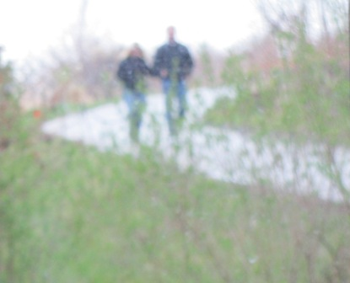
Introduction
Today we will talk about healthy and unhealthy relationships.
By working on improving relationship skills, we can have more supportive relationships.
Families, socialization, and relationships are very important to successful recovery.

Slide 3
Goals and Objectives
To increase awareness of relationship issues on mental health and recovery
To describe a relationship pattern you see in your family
To choose a relationship skill to work on (increase assertiveness, decrease co-dependency, decrease isolation, reduce fear and stigma, or manage chaos)
To list one or more ways to help improve your chosen relationship skill

Slide 4
Family and Relationship Issues
We are shaped by those who raised us (parents and/or caregivers), and other human relationships.
We need people close to us in our lives - people without supportive relationships tend to have more illness.
Individual differences can cause conflict, loss of intimacy, and problems parenting children.
Communication and good relationship skills are needed to meet certain challenges.

Slide 5
Humans are Social Beings
If you ever played Sims (a computer game similar to Second Life), what happens when the Sims avatar does not have enough friends, fun, or social activities during the game? It slumps over, shakes its arms, gets depressed, falls down, and may even die.
Is it easy to get enough social time in the Sims game? No.
Are you affected when you don’t get enough social time (in real life)? If so, how?

Slide 6
Your Mental Health
What does being healthy mean to you?
A feeling of mental well-being?
Being able to do the things you want to do?
Taking care of yourself?
Enjoying social activities and relationships?

Slide 7
What is Mental Health?
A state of successful performance of mental and physical functioning resulting in productive activities, fulfilling relationships with others, the ability to adapt or change and to cope with adversity.
US Dept. Health & Human Services (1999). A report of the Surgeon General. Rockville, MD
There is not one "official" definition of mental health according to the World Health Organization.
World Health Organization. (2001). World Health Report 2001-Mental Health: New understanding, new hope. Retrieved 2008 from http://www.who.int/whr/2001/en/index.html

Slide 8
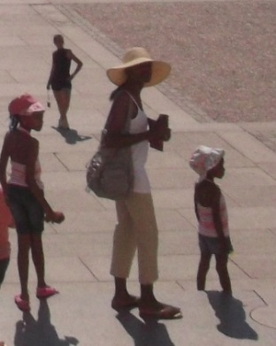
What is a Relationship?
Connection between people by blood or marriage
An emotional or other connection between people
Sexual involvement or affair
Modified from Dictionary.com 2006.
What kind of relationships are important to you in your recovery?
They all may be important, but many people think family relationships are most important.

Slide 9
What is a Family?
Parents and their children, whether dwelling together or not
The spouse and/or children of one person
Any group of persons closely related by blood, as parents, children, siblings, uncles, aunts, and cousins
Modified from Dictionary.com 2006.
People can’t choose the family they are born into, but you can choose your friends (another kind of family).
How can your family affect your health and recovery?

Slide 10
What is your Family Relationship Pattern?
Disconnected/Avoidant – Families that hide their stress or mask it with physical symptoms. They usually are uncomfortable asking for or accepting help.
Confused/Chaotic – Families that are very needy and have a crisis often. There is added confusion and chaos if they don’t use a consistent health care team, but go to many different health care providers.
Secure/Balanced – Families that seek help when distressed and follow a plan of action to deal with the problem at hand.
Reiss-Brennan, B., Oppenheim, D., & Kirstein, J.I. (2002). Rebuilding family relationship competencies as a primary health intervention. Primary Care Companion Journal of Clinical Psychiatry. 4 (2) p. 41-53.

Slide 11
Functions of a Family
Giving assistance and resources
Making decisions, communicating, and problem solving together
Nurturing (helping each other grow up healthy), along with freedom to change
Experiencing intimacy and emotions
Committing time, space, and money
Modified from Barkauskas et al, 2002 (Family APGAR) as cited in Stuart, G. W. & Laraia, M. T. (2005). Families as resources, caregivers, and collaborators. Principles & practice of psychiatric nursing (8th ed., pp. 172-173)) St. Louis: Elsevier Mosby.

Slide 12
Ways to Improve Relationships
Increase assertiveness – Stand up for your rights when interacting with people. (Avoid aggressive or passive behavior.)
Decrease co-dependency – Change one-sided, emotionally abusive relationships to healthier, satisfying relationships.
Decrease isolation – Maintain a satisfying level of intimacy and social activity.
Reduce stigma – Educate, empower, and cope.
Manage chaos – Work with your health care team, organize activities, and have a consistent schedule.
*** Choose one of these skills to discuss and to improve on.

Slide 13
Increase Assertiveness***
Speak up to correct the situation if your rights are being violated.
Seek respect and understanding for your feelings.
Interact in a mature way, even if others are acting offensive, defensive, or aggressive.
Confront problems or disagreements “head on.”
Find “win-win'' solutions instead of just giving in.
Believe “I deserve to stand up for my rights.”
Messina, J. J. (2010). Improving Assertive Behavior. Retrieved from http://jamesjmessina.com/toolsforrelationships/assertivebehaviors.html
See assertiveness techniques below. Also, read examples in Situations for Assertiveness Handout or the Teen Situations for Assertiveness Handout. Practice by reading them aloud.

Slide 14
Be Assertive: Use “I” Statements
Start your sentence with an “I”
Voice your feelings and wishes without expressing a judgment about the other person.
Do not blame that person for your feelings
“I” statements help people feel less defensive.
AssertivenessTechniques adapted from: BBC’s hcg2 website. (2004). Assertiveness and assertiveness training. Retrieved from http://www.bbc.co.uk/dna/h2g2/A2998551

Slide 15
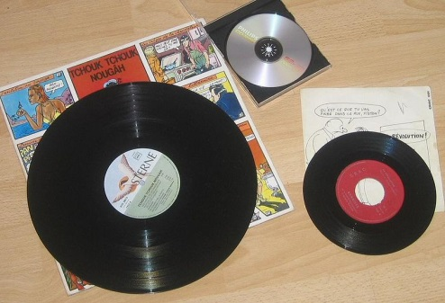
Be Assertive: Like “Broken Record”
When the other person starts saying why they can’t do what you want them to, politely but firmly repeat the request.
Remind the other person of the need.
Do not let them distract you or change the subject.
Compromise may still be needed.

Slide 16
Be Assertive: Use “Fogging”
Train yourself to stay calm when someone is criticizing you.
You may agree with parts of the statement that may be fair or useful.
Or, you could agree in principle with what the other person is saying.
You could say, “You have a point there,” or “That may be true.”
By refusing to be provoked and upset, the criticism loses its power over you.

Slide 17
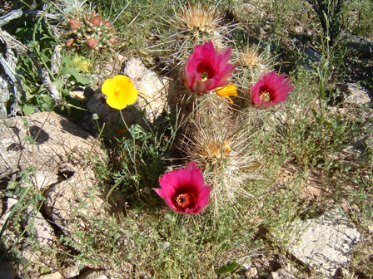
Be Assertive: Use DESC Scripting
Describe the situation.
Express what you are feeling.
Specify what you would like to happen.
Consequences
Explain the negative things that will happen if you don’t get what you want.
Or explain positive things that will happen if you do get what you want.

Slide 18
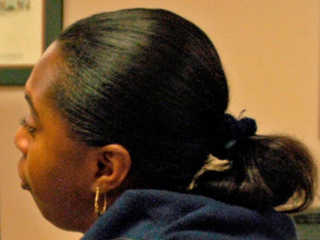
Be Assertive: Use Negative Assertion (Agree in Part)
If a person who is complaining has something to say that is true, you can agree with part of what they said.
You can admit, “Yes, you’re right. I’m late. I’ll try to be more organized.”
Don’t beat yourself up because you have been criticized.
Or, you can own up to your mistakes before anyone starts to complain.

Slide 19
Accept Compliments
It is also important to accept compliments that are sincere
If you are not assertive, you tend to doubt or deny compliments that are given to you.
It is OK to agree with nice things that are said about you. If you disagree, don’t argue about it.
It is OK to give credit to others as well as yourself for a job well done.
Be kind to yourself. When you judge yourself, don’t be any harsher than you would be to anyone else in your situation.
If you don’t know what to say, just say, “Thank you.”

Slide 20
Discussion
What are some examples of non-assertive behavior?
Oh, it's nothing. I’m OK.
That's all right; You can have it. I didn't want it anyway.
Go ahead; my idea wasn’t very good.
How would non-assertive behavior make you feel different than assertive behavior, even if the outcome of the situation was the same?
Which assertiveness techniques have you used?
Which one would you like to try?

Slide 21
Discussion
Why do you think some people feel guilty when being assertive?
Is it harder for people with a strong need for approval to be assertive?
Doing anything to hold on to relationship and avoid feeling of abandoned could be called relationship addiction.
An unhealthy dependence on someone could be called (co-dependence).
What relationship issues do you see in your family or your relationships? How do they affect you?

Slide 22
Decrease Codependency***
Codependency involves low self esteem and is sometimes referred to as being an “enabler.”
Family members may detach or “separate themselves” so they can deny, ignore, or avoid difficult emotions.
They focus on a family member who is ill or addicted, not on their own health and safety.
Protecting them allows the ill person to continue destructive behaviors like addiction to drugs, alcohol, work, food, sex, gambling, or toxic relationships.
When co-dependent, people become even more dependent.

Slide 23
Co-dependency Resources
By learning more about co-dependency, families can cope better and become more assertive.
By reaching out for help, people can live a healthier, more fulfilling life. Help may include:
Family counseling
Community crisis teams, hotlines, and resources
Your health care provider and/or clinic staff
Nurse advisors
Adapted from National Mental Health Association. (2006). Factsheet: Co-dependency. Retrieved from www.nmha.org/go/codependency

Slide 24
Optional Handouts
If the previously discussed relationship skills do not apply to you, use these handouts for more ideas:
Healthy Personal Boundaries Lesson
Unhealthy Boundaries Checklist
Controlling Behavior
Patience and How to Develop It
Decide which relationship skill you want to work on.
Get more information by discussing it with your health care team, using patient education resources, or use the health care websites listed on the Community Resources Handout.

Slide 25
Homework
Discuss or write in your journal which family pattern was in the family you grew up with? Which pattern was in your current family?
How does your family relationship pattern affect you?
Contact National Association for Mental Illness (NAMI) for support if you or a family member have a mental illness.
Discuss with your family what you plan to do to improve your relationships and why.

Slide 26
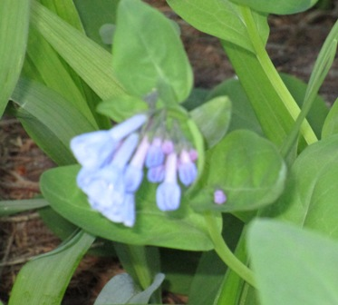
Conclusion
People who assertively express their feelings, thoughts, and desires tend to maintain healthier relationships.
If you improve your relationship skills, you may gain self-esteem and courage.
With support from others, you can cope better, and an improved feeling of wellness.
Good relationships make a big difference on your journey toward recovery.

Slide 27
This lesson was developed in 2009 and revised 6-8-15 by
Mary Knutson, RN

