Slide 1
Managing Food Allergies
A Guide for Schools

Slide 2
Food Allergies are Serious!
35-50% of allergic reactions that progress to anaphylaxis are the result of food allergens
60% of those cases were caused by nuts (peanuts & tree nuts)
16-18% of children with food allergies have had an allergic reaction in school
25% of all anaphylaxis cases in schools occurred in children with no known food allergies
(CDC, 2016)

Slide 3
What is a Food Allergy?
A bad reaction (from a specific immune response) that occurs when exposed to a type of food
In people with food allergies, the body mistakenly responds to food as if it were harmful
Allergies to food can cause responds that range from mild to severe and life-threatening
(CDC, 2016)

Slide 4
Common Food Allergies
In the United States, the following eight foods or food groups cause 90% of serious allergic reactions:
Milk
Eggs
Seafood
Shellfish
Wheat
Soy
Peanuts
Tree nuts
(CDC, 2016)

Slide 5
Signs & Symptoms of Allergies
Red watery eyes or swollen lips, tongue, or eyes
Itchiness, flushed skin, rash, or hives
Nausea, pain, cramping, vomiting, diarrhea, or heartburn
Nasal congestion, sneezing, trouble swallowing, dry cough
Numbness around mouth
Deep cough, wheezing, shortness of breath or difficulty breathing, or chest tightness
Pale or bluish skin color, weak pulse, dizziness or fainting
Confusion or shock, low blood pressure, or fainting
Sensing “impending doom,” irritability, change in alertness, or mood changes
(CDC, 2016)

Slide 6
Food Allergies & Children
Signs & symptoms can start within a few minutes or up to 1-2 hours after exposure to an allergen
Children may not be able to describe their symptoms clearly because of their age or developmental challenges
It is hard to predict how severe the reactions to food allergies because they depend on the child’s health history and:
How sensitive they are to the food
The type and amount of exposure to the food
(CDC, 2016)

Slide 7
What Children Might Say
“It feels like something is poking my tongue”
“My tongue (or mouth) is tingling (or burning)”
“My tongue (or mouth) itches”
“My tongue feels like there is hair on it”
“It feels like a bump on the back of my tongue (or throat)”
“It feels like there’s something stuck in my throat”
“My tongue feels full (or heavy)”
“My lips feel tight”
“It feels like there are bugs in my ears (for itchy ears)”
“My mouth feels funny”
(CDC, 2016)

Slide 8
Be Ready for Emergencies
Be alert and ready to respond to food allergies when they happen
If children eat the food, it usually causes a more severe reaction than inhaling it or having it on their skin
Children with asthma are at a higher risk of having a severe allergic reaction and of entering anaphylactic shock
Mild or moderate symptoms (itching, sneezing, hives, or rashes) are often treated with antihistamines, steroids, and/or asthma inhalers
If anaphylaxis happens, that should be treated first
Anaphylaxis is a true emergency!

Slide 9
What is Anaphylaxis?
A severe allergic reaction that is happens quickly and may cause death
Usually occurs within minutes after exposure
IMMEDIATE MEDICAL INTERVENTION REQUIRED
Death due to food-induced anaphylaxis may occur within 30 minutes to 2 hours of exposure
(Mayo Clinic, 2016)

Slide 10
Recognize Anaphylaxis
Skin reactions, including hives along with itching
Flushed or pale skin usually happens
A warm or hot sensation
A weak & rapid pulse
Sensing a lump in the throat
Narrowing of the airways and a swollen tongue or throat can cause wheezing or trouble breathing
Nausea, vomiting or diarrhea
Dizziness or fainting
(Mayo Clinic, 2016)

Slide 11
Treat Anaphylaxis
The first thing to do is Give Epinephrine (EpiPen)
Early use of epinephrine for anaphylaxis improves a person’s chance of survival and quick recovery
Rapidly improves breathing
Improves heart rate
Reduces swelling of the face, lips, and throat
Once administered, call 911 even if symptoms have resolved
Up to 20% of anaphylactic reactions return within 4–8 hours
(CDC, 2016)

Slide 12
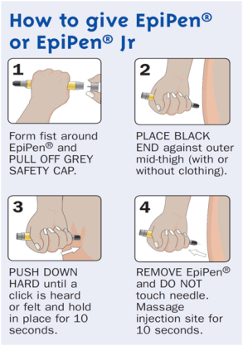
How to Administer an EpiPen
Lay the person flat to ensure safety!
After steps 1 - 4 are complete call 911!
(NPS MedicineWise, 2016)

Slide 13
Develop a School Treatment Plan
If an allergic reaction or anaphylaxis occurs:
Call the school nurse at ______ OR call the __________ at ________
Refer to the health form that is filed in the classroom, lunchroom, and/or health office
For SEVERE symptoms - Give epinephrine if you have been trained
If students have medications in the school office for this reason, and you are allowed to give them, USE THEM

Slide 14
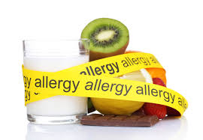
Manage Food Allergies
Helping students manage food allergies takes a team effort with school staff, parents, and emergency health services
Parents are an important resource for health questions
The school nurse is available for questions, training, and resources
Know your school’s Emergency Treatment Plan and health policies. If you are a substitute teacher, read the Emergency Plans at the start of the day

Slide 15
Keep Students Involved
Review with students the signs & symptoms of allergic reactions
Stress the importance for the child to voice any possible symptoms
Reassure students that you will help with their allergy care & treatment

Slide 16
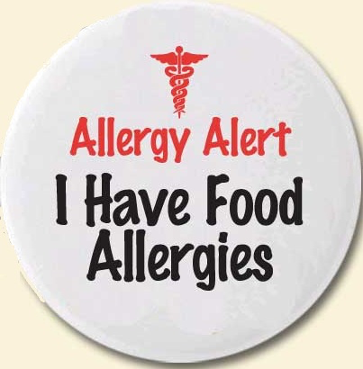
What Teachers Can Do
Ask parents to provide a list of foods and ingredients their child must avoid
Keep information readily available about each food-allergic student in your class (This is helpful for substitutes & adjunct staff)
Make sure the child eats in a Safe Zone - such as a Peanut Free Table
Discourage students from trading food
Post allergy safe signs outside of the classroom door & near the snack cupboard
Send out a letter to parents explaining allergies and listing approved snacks

Slide 17
Summary
A food allergy is an adverse health reaction from a specific immune response that happens when exposed to a certain food
Common food allergies include: milk, seafood, shellfish, peanuts, tree nuts, wheat, milk, and soy
Common symptoms may include: itchiness, dry cough, swollen lips or tongue, rash, and shortness of breath
Anaphylaxis is a severe allergic reaction that can result in death & requires immediate treatment with epinephrine
After giving epinephrine - CALL 911 even if symptoms have resolved
All staff, parents, and emergency health services must work together to manage food allergies and keep students safe

Slide 18
References
Centers for Disease Control and Prevention. (2016). Voluntary Guidelines for Managing Food Allergies In Schools and Early Care and Education Programs. Retrieved from https://www.cdc.gov/healthyschools/foodallergies/pdf/13_243135_a_food_allergy_web_508.pdf
Mayo Clinic. (2016). Anaphylaxis. Retrieved from http://www.mayclinic.org/diseases-conditions/anaphylaxis/basics/symptoms/con-20014324
NPS MedicineWise. (2016). Adrenaline Autoinjector (Anapen) for Acute Allergic Anaphylaxis. Retrieved from https://www.nps.org.au/radar/articles/adrenaline-autoinjector-anapen-for-acute-allergic-anaphylaxis
Adapted from a Powerpoint originally developed by Deziree Earney, RN Student October, 2016.

