Slide 1
Managing Guilt
Lesson 49T
Empowerment

Slide 2
Introduction
Element of Recovery: Empowerment
Topic: Managing Guilt
Our emotions and relationships can be affected by feelings of guilt
We will learn about some healthy and unhealthy ways to relate to people in your life
By recognizing them, there is a chance to improve our mental health, coping skills and relationships during recovery

Slide 3
Goals and Objectives
To recognize how guilt feelings affect your health, and to learn healthier ways to respond
To gain “tools” for coping to increase empowerment during recovery
To describe what “makes you feel guilty”
To discuss manipulation
To discuss irrational (unreasonable) beliefs involved in guilt
To list a way to improve a guilt feeling you have

Slide 4
What Is Guilt?
Feeling responsible for negative things that happen to you or others
Accepting responsibility for someone else’s problem
Regret for real or imagined mistakes, past or present
Feeling like you should have done more
Feeling loss or shame for not doing something
Guilt can come from irrational or faulty beliefs
Discussion: What “makes you” feel guilty?
How does guilt “make you” feel?

Slide 5
Negative Affects of Guilt
If you let it, guilt can “make you feel sad and stressed out and/or:
Over-responsible, and over-worked
Over-conscientious or too careful
Over-sensitive, sad, tense, or anxious
Immobilized or “paralyzed”
Have more trouble making decisions
Take care of others first, instead of yourself (self-denial)
Ignore emotions and feelings that could be enjoyed

Slide 6
Positive Effects of Guilt
Guilt is not always a bad thing – It is OK to feel guilt if you did something you shouldn’t have done
It can help make moral decisions
The discomfort of guilt can motivate people to change
Coping techniques and therapy can help decrease guilt and negative thinking - It can also help control stress and tension in your life
Guilt can lead you to recognize irrational beliefs that you were not aware of

Slide 7
Some Irrational Beliefs
“No matter what I do, I am always wrong”
“I am responsible to keep my family happy”
“It’s my fault if they fail in any way”
“There is only one right way to do things”
“I have to do what people expect of me”
“It’s wrong to be concerned about myself”
“I should never feel guilty”
“No one should feel hurt or pain.”
“No one should die.”
“I don’t deserve to be happy”

Slide 8
Case Study
Dawn was a young woman whose friend recently died in a car accident. She was so sad and upset that she couldn’t face seeing other people, and didn’t go to work or school.
She blamed herself for her friend’s death because Dawn had asked her get something at the store just before she was hit by the car.
She told herself over and over, “If she didn’t go home from work that way, that car would never have hit her. It’s all my fault –It should have been me.”
Discussion: Is Dawn responsible for the accident? No
Why do you think she blames herself? Guilt could be from irrational thinking, depression, and poor self-esteem

Slide 9
Where Does Guilt Come From?
In this case, Dawn is blaming herself - The guilt comes from within herself
But guilt can come from others. If someone told Dawn the crash may have been during a cell phone call, they could “make” Dawn feel guilty even if she hadn’t called her at that time (or if her friend made the unsafe choice to answer the phone while she was driving)
Sometimes people try to make you feel guilty, or manipulate you (use your guilt to benefit them)
You can either feel guilty, or you can stop feeling guilty – The first step is to be aware

Slide 10
How People Increase Your Guilt
Giving you a sense of blame for past, present, or future actions by saying you were at fault (making up a story)
Accusing you of being the one with a problem
Encouraging negative thinking about yourself
Limiting choices to those that result in some guilt
Saying they will suffer if you don’t do what they want
Faking problems, illness, unhappiness, or other negative behavior to add guilt (so you do more for them)
Threatening things, like going to jail, hospital, failing, etc.

Slide 11
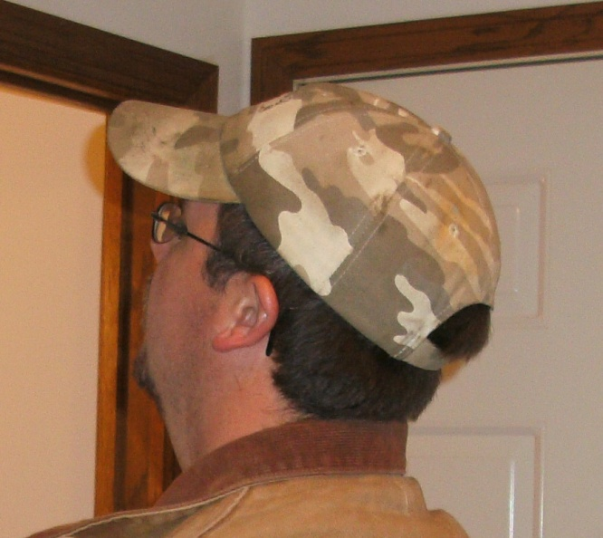
Case Study
A young man named Jeff told his mother: “I lost my job today, and it’s all your fault. I didn’t like the sandwich you made, so I had to go out for lunch. I had a beer, and when I came back to work, they fired me. I don’t think you care about me at all. I feel like punching something.”

Slide 12
Unhealthy Response
His mother said, “I’m sorry. I ran out of the sandwiches you like, but I’ll never do that again. I know that if you hadn’t left work, you wouldn’t have been tempted to drink.
You mean everything to me. You can live here as long as you want to. I’ll help you find another job.”

Slide 13
Healthy Response
His mother said, “If you are trying to make me feel guilty, it’s not working.
Your problem was not because of the sandwich I made. You lost your job because you chose to drink alcohol.
You know I love you, but you have to get serious about keeping a job. I can’t do it for you. You will need to live on your own someday.”

Slide 14
Learning Activity: Discussion
Which of these issues occur with unhealthy responses?
Intimidation
Idealism
Need to fix
Caretaker behaviors
Letting go of the uncontrollables and unchangeables
Unconditional acceptance and love
Over-dependency
Manipulation
Developing self-control

Slide 15
How to Overcome Guilt
Recognize the true problem
Realize you can’t control others (You can only control and change yourself)
Sometimes you need to let go of the need to control others
Use self-affirmations to strengthen your belief in yourself
Avoid being manipulated if someone tries to benefit from your feelings of guilt
Use “I” statements – Speak for yourself
Learn to cope better

Slide 16
Recognize the True Problem
Ask yourself:
What is the problem?
Whose problem is it really?
Recognize your feelings of guilt.
Is my guilt making the problem look bigger than it is?
How would it look if I didn’t have the guilt?
Give the problem back, if it is someone else’s
Even if you feel some guilt, you don’t have to accept it - You may have done nothing wrong

Slide 17
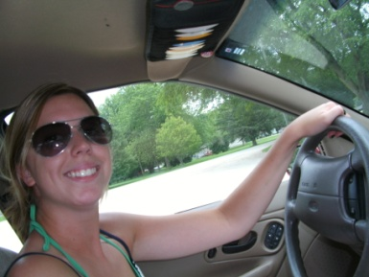
Realize You Can’t Control Others
Myth: I should be in control of everything important in my life.
Reality: You are powerless to control most people, places, and things in your life. You can only be fully in control of your own thoughts, emotions, and actions.
Many people, places, and things in your life are uncontrollable and unchangeable

Slide 18
Let Go of the Need To Control Others
If you want to control, fix, change, rescue, enable, or correct others you may need the LET GO System:
L Lighten Pressure – Become more rational and realistic
E Exercise Rights – You have the right to say you can’t change or control other people
T Take Steps – Accept personal responsibility for your own life
G Give Up Need – Embrace meaning of the Serenity Prayer – Accept the things you cannot change
O Order Life – Nurture healthy relationships and learn tools for coping
Messina, J. J. & Messina, C. (2010). From http://www.jamesjmessina.com/seastoolsforrecovery/letgosystem.html

Slide 19
Use Self-Affirmations
I am a good person. I need only my own approval, admiration, and acceptance.
I accept and love myself unconditionally - even when I make mistakes.
I am a worthwhile person that deserves respect.
I am improving my outlook as I recognize guilt and negative thinking
Using my strengths and abilities, I will get what I need to succeed
Discussion: Do you believe these statements?
How does it feel to say them aloud?

Slide 20
Avoid Being Manipulated
People may try to get what they want even when others are not willing to give it freely
To “con” or get people to believe something that isn’t true
Make others feel like they are responsible for their situation, so they don’t have to fix it themselves
Manipulation is less likely if you have good self-esteem and you believe in yourself
Manipulation happens easier if your feelings depend more on what other people think

Slide 21
Use “I” Statements
Speaking for yourself is sometimes called using 'I' messages
With "I" statements, people are less likely to be defensive, so you are more likely to be heard
When using "I" statements, you talk about your own thoughts, feelings, and intentions
“You" statements are not as healthy because they tend to label, blame, and defend, rather than communicate feelings
With "you" statements, we seem to make the other person responsible for our feelings
People tend to hear your opinions and judgment of them instead of listening to what your underlying feelings are

Slide 22
Learning Activity: Using “I” Statements
Try filling in the blanks with how you feel:
“I feel __so angry!__”, followed by “You make me feel__so angry!__
“I feel __bad about it__”, followed by “You make me feel__bad about it__
“I feel __like I can’t do anything right__”, followed by “You make me feel__like I can’t do anything right__
Compare how the “I” or “you” phrases change how you feel when you say it, or when you hear it said to you?

Slide 23
Learn to Cope Better
Coping with stress, anxiety, and depression can help decrease feelings of guilt
Recognize negative thinking and irrational thinking, then replace them with positive, realistic thinking
Educate yourself and focus on problem solving
Do activities you enjoy
Take good care of yourself and your body
Find supportive relationships and end toxic relationships

Slide 24
Optional: What Are “Toxic” Relationships?
“I feel criticized, like whatever I do isn’t enough”
“We argue about things that don’t even matter”
“I feel guilty most of the time”
“I’m afraid to ask for what I really want”
“I feel negative or hopeless about myself and the relationship”
“I put the needs of others ahead of my own too much - It is unhealthy for me”
“I know it is a toxic relationship. It will be hard, but I have to end it. Then I can recover from the guilt, depression and anxiety it causes.”

Slide 25
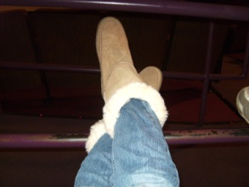
Do any of these pictures remind you of unhealthy relationships?
Trying to make you feel guilty
Telling you what to do and when
Pushing you away with “barbs”
Pulling you in with “hooks”
Not listening to what you need, but thinking only of themselves
Making you feel “trapped”, hopeless, or “used”
Arguing a lot, or controlling your time
Disrespectful or violent behavior
Verbal, physical, or sexual abuse

Slide 26
Conclusion
Healthy self-esteem includes not feeling guilty about things you can’t control
Be kind to yourself
Recovery can be more successful if you are more respectful and honest toward yourself
Even if we can’t change other people, we can change ourselves and our attitudes
Focus on your healthy relationships instead of unhealthy ones during recovery

Slide 27
References
Foster, A. & Roberts, V. Z. (Eds).(1998). Managing mental health in the community: Chaos and containment. Florence, KY, US: Taylor & Frances/Routledge.
Messina, J. J. (n.d.). Eliminating manipulation. Retrieved 9-8-09 from http://www.livestrong.com/article/14680-eliminating-manipulation
Messina, J. J. (n.d.). Handling guilt. Retrieved 9-8-09 from http://www.livestrong.com/article/14689-handling-guilt
Messina, J. J. & Messina, C. (2010). From http://www.jamesjmessina.com/seastoolsforrecovery/letgosystem.html

Slide 28
This Recovery Education lesson was developed in 2009. Revised 12-29-21 by Mary Knutson RN of Health Vista, Inc.

Slide 29
Describe how any of these pictures remind you of unhealthy relationships

Slide 30
Describe how any of these pictures remind you of unhealthy relationships

